Slide 1
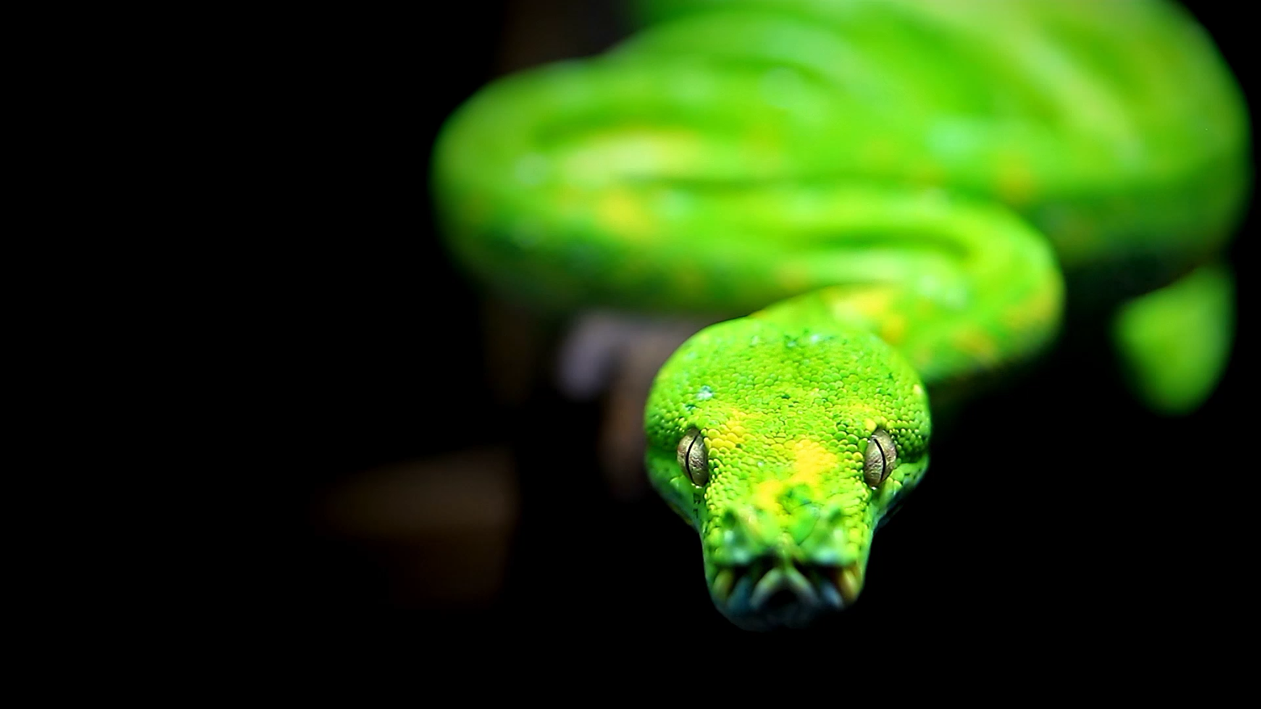
Where to Run Python and Jupyter Notebooks on macOS
A quick guide to safe and organized environments for .py and .ipynb files

Slide 2
✅ Recommended Locations for Notebooks
~/Documents/PythonProjects/ – Ideal for custom scripts and organized work
~/Downloads/ – OK for temporary testing
~/Desktop/ – Quick experiments, can get cluttered
~/Notebooks/ or ~/Jupyter/ – Clean, focused notebook workspace
~/ – Your home directory (safe, but keep it tidy)

Slide 3
⚠️ Avoid These Locations
/opt/homebrew/... or /Library/Frameworks/... – System directories with no write access
~/anaconda3/envs/... – For environments only, not notebook files

Slide 4

🧭 Check Your Working Directory
In Terminal:
pwd
In Jupyter Notebook:
import os
print(os.getcwd())

Slide 5
📁 Create a Safe & Clean Working Environment
mkdir -p ~/Projects/DataScience/Notebooks
cd ~/Projects/DataScience/Notebooks
jupyter notebook

Slide 6

🧼 Organize Projects Cleanly
~/Projects/
└── ML_Course/
├── data/
├── notebooks/
├── scripts/
└── results/

